Slide 1
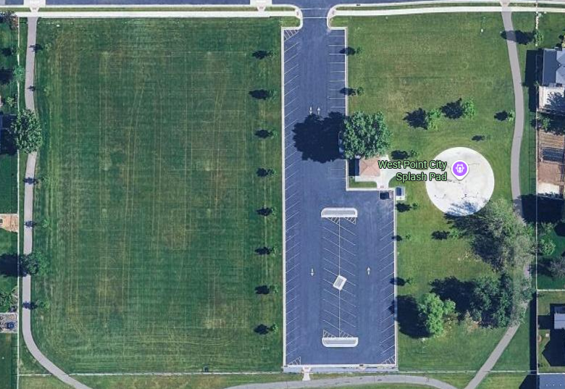
Start
6
8
7
5
Troop
9
4
1
3
2
0

